Slide 1
Annual review
Richard W.M. Jones <rjones@redhat.com>

Slide 2
virt-v2v
166 commits (since version 1.36 / Feb 2017)
Top committers:
Richard Jones
Pino Toscano
Tomáš Golembiovský
Pavel Butsykin

Slide 3
virt-v2v
Faster imports from VMware via:
VMX
VDDK
Encrypted guests
Preserving CPU model and topology

Slide 4
virt-v2v – future features
Live conversion
Deeper integration with:
CFME
oVirt and RHV

Slide 5
nbdkit
88 commits (since version Jan 2017)
Top committers:
Richard Jones
Eric Blake
Pino Toscano

Slide 6
nbdkit
import nbdkit
disk = bytearray(1024 * 1024)
def open(readonly):
return 1
def get_size(h):
global disk
return len (disk)
def pread(h, count, offset):
global disk
return disk[offset:offset+count]
def pwrite(h, buf, offset):
global disk
end = offset + len(buf)
disk[offset:end] = buf

Slide 7
nbdkit
Authentication and encryption (TLS)
VDDK plugin
Correct handling of errno
Write zeroes
systemd Socket Activation
New-style protocol
“Exit with parent”

Slide 8
nbdkit – future features
Structured reads
Incremental backups
Disk resizing

Slide 9
libguestfs
422 commits (since version 1.36 / Feb 2017, excluding v2v)
Top committers:
Richard Jones
Pino Toscano
Matteo Cafasso
Pavel Butsykin

Slide 10
libguestfs
Thread-safe API (but still non-parallel)
Virt-rescue enhanced
Inspection done all inside the daemon
Use OCaml code in the daemon
⇨ Mostly a clean-up release

Slide 11
virt-what
23 commits (since Oct 2016)
Top committers:
Richard Jones
Thomas Huth and 8 others with 1 or 2 commits

Slide 12
virt-what
POWER
S/390
Oracle Ldoms
OpenBSD bhyve
QEMU TCG-only
Amazon AWS

Slide 13
hivex
20 commits (since Nov 2016)
Top committers:
Richard Jones
Dawid Zamirski
Hilko Bengen
Pino Toscano

Slide 14
hivex
Better handling of corrupt/incomplete hives
⇨ libguestfs can now inspect almost all Windows guests even if they crashed, abruptly powered off, or have a corrupt Registry

Slide 15
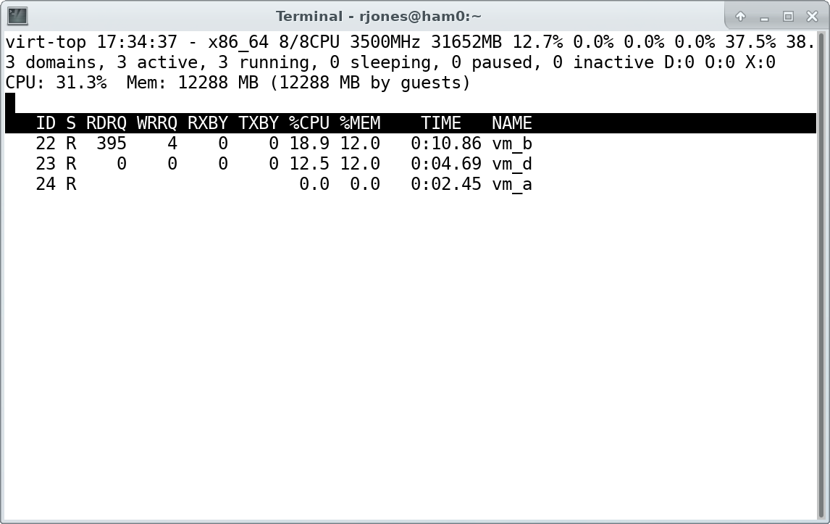
virt-top
12 commits (since Jan 2017)

Slide 16
virt-top
Huge performance improvements thanks to better libvirt stats APIs contributed by Fujitsu

Slide 17
The rest
miniexpect
virt-builder
virt-dib
Fedora/RISC-V

